Slide 1
How can teachers learn to be better teachers?
@ProfCoe
Robert Coe, Durham University
Bryanston June 2017

Slide 2
How can teachers learn to be better teachers?
You’re a teacher.
You know how to help people learn hard stuff.
Do that.

Slide 3
Notes:
https://www.gov.uk/government/publications/standard-for-teachers-professional-development
Cordingley, P., Higgins, S., Greany, T., Buckler, N., Coles-Jordan, D., Crisp, B., Saunders, L., Coe, R. (2015) Developing Great Teaching: Lessons from the international reviews into effective professional development. Teacher Development Trust. http://tdtrust.org/about/dgt/
The CPD Test: http://tdtrust.org/cpdtest/

Slide 4
What do we know about teachers’ professional learning?
Three types of requirement
General principles of how people learn anything
Specific requirements for learning to change pedagogical practice
The learning environment: school culture and leadership

Slide 5
All good learning & teaching …
Takes you from where you are at
Is clear what success looks like
Creates challenging expectations
Assesses and feeds back on the gap
Requires exposition and guidance from an expert
Requires a coaching & mentoring role
Benefits from peer support
Requires trust: ‘OK to fail’

Slide 6
Principles for learning to change pedagogical practice
Learning aims (for teachers) must be strongly linked to learning gains (for pupils)
Learning aims must be evidence based
Learning aims must be appropriate to school/pupil context
Changing habits that are already established is very hard (needs time, support, feedback)
Pedagogy is a blend of theory (wisdom and intuition) and practice (skills and techniques)

Slide 7
Leadership, school culture and professional learning
The value of professional learning and continuous improvement must be clearly signalled (championed and modelled)
Time and funding must be made available
A trust culture (‘willingness to be vulnerable’ = please observe my worst lesson) is vital
Challenge implies need for improvement
Requires coherence with a wider strategic planning process for prioritisation and integration
Notes:
Tschannen-Moran, M., & Hoy, W. K. (2000). A multidisciplinary analysis of the nature,
meaning, and measurement of trust. Review of Educational Research, 70(4), 547-593.

Slide 8
Some general principles of (professional) learning
Get the learning aims right
Use assessment (for learning)
Don’t forget teaching
Culture is crucial
Practice makes less imperfect

Slide 9
General principles of (professional) learning: 1. Get the learning aims right

Slide 10
How might learning aims for professional learning be wrong?
Set out to learn to do something that will make no difference to student learning
Learning aims (for teachers) must be strongly linked to learning gains (for pupils)
Underestimate the power of habit
Especially unlearning bad habits
Build on an inadequate theory of pedagogy
Pedagogy is a blend of theory (wisdom and intuition) and practice (skills and techniques)

Slide 11
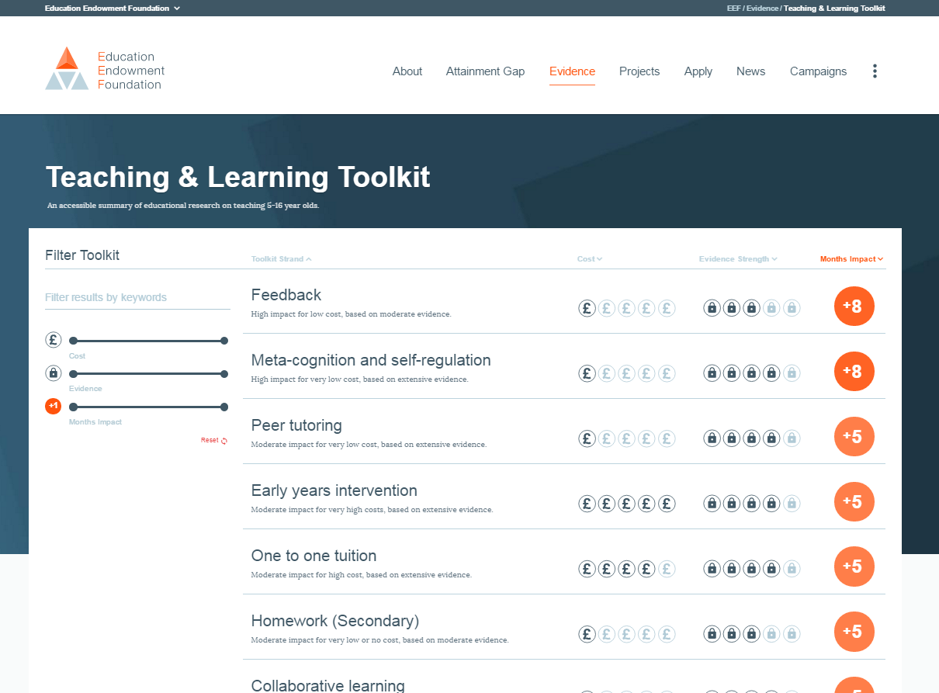
EEF Teaching and Learning Toolkit www.educationendowmentfoundation.org.uk/toolkit
Notes:
Higgins, S., Katsipataki, M., Kokotsaki, D., Coleman, R., Major, L.E., & Coe, R. (2013). The Sutton Trust-Education Endowment Foundation Teaching and Learning Toolkit. London: Education Endowment Foundation. [Available at http://www.educationendowmentfoundation.org.uk/toolkit]
Hattie, J. (2009) Visible Learning: A synthesis of over 800 meta-analyses relating to achievement. Abingdon: Routledge.

Slide 12
Impact vs cost
www.educationendowmentfoundation.org.uk/toolkit
Most promising for raising attainment
8
Feedback
May be worth it
Meta-cognitive
Mastery
Homework (Secondary)
Peer tutoring
1-1 tuition
Early Years
Effect Size (months gain)
Reading comprn
Collaborative
Behaviour
Phonics
Small gp tuition
Parental involvement
Smaller classes
Social
ICT
Individualised learning
Summer schools
After school
Small effects / high cost
Homework (Primary)
Mentoring
Teaching assistants
0
Performance pay
Aspirations
£0
Ability grouping
£1000
Cost per pupil
Repeating a year

Slide 14
Dimensions of great teaching
(Pedagogical) content knowledge (PCK)
Quality of instruction
Classroom management / behaviour / control
Classroom climate / relationships / expectations
Beliefs (theory) about subject, learning & teaching
Wider professional elements: collegiality, PD, stakeholder relationships
Notes:
Coe, R., Aloisi, C., Higgins, S. and Elliot Major, L. (2014) ‘What makes great teaching? Review of the underpinning research’. Sutton Trust, October 2014 http://www.suttontrust.com/researcharchive/great-teaching/

Slide 15
1. We do that already (don’t we?)
Reviewing previous learning
Setting high expectations
Using higher-order questions
Giving feedback to learners
Having deep subject knowledge
Understanding student misconceptions
Managing time and resources
Building relationships of trust and challenge
Dealing with disruption

Slide 16
2. Do we always do that?
Challenging students to identify the reason why an activity is taking place in the lesson
Asking a large number of questions and checking the responses of all students
Raising different types of questions (i.e., process and product) at appropriate difficulty level
Giving time for students to respond to questions
Spacing-out study or practice on a given topic, with gaps in between for forgetting
Making students take tests or generate answers, even before they have been taught the material
Engaging students in weekly and monthly review

Slide 17
3. We don’t do that (hopefully)
Use praise lavishly
Allow learners to discover key ideas for themselves
Group learners by ability
Encourage re-reading and highlighting to memorise key ideas
Address issues of confidence and low aspirations before you try to teach content
Present information to learners in their preferred learning style
Ensure learners are always active, rather than listening passively, if you want them to remember

Slide 18
Professional reading http://cem.org/blog/what-is-worth-reading-for-teachers-interested-in-research
Reports (online & free)
Effective pedagogy (6)
Impact of interventions (3)
How learning happens (8)
Teachers’ PD (2)
School improvement and leadership (3)
Books (8)
Blogs (10)

Slide 19
Further reading lists
Tom Sherrington (@Teacherhead)
https://teacherhead.com/2017/06/03/teaching-and-learning-research-summaries-a-collection-for-easy-access/
Harry Fletcher-Wood (@HFletcherWood)
https://improvingteaching.co.uk/2017/06/04/a-reading-list-learning-teaching-professional-development/
Nick Rose (@Nick_J_Rose)
https://www.tes.com/news/tes-magazine/tes-magazine/are-these-7-pillars-classroom-practice?amp
Paul Kirschner (@P_A_Kirschner)
https://3starlearningexperiences.wordpress.com/2017/02/28/seminal-papers-in-educational-psychology/

Slide 20
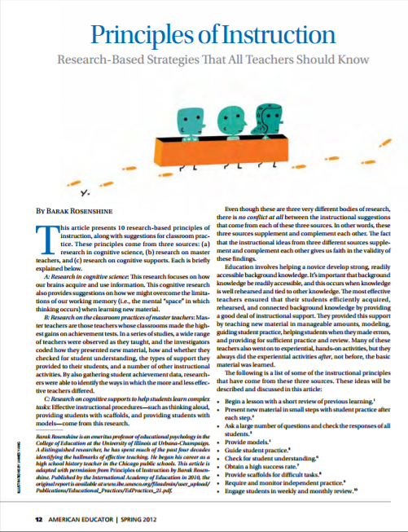
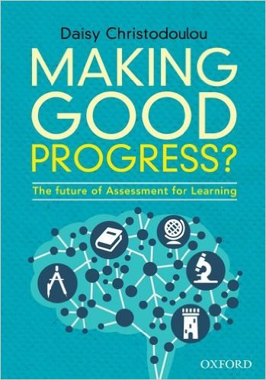
Starter pack: 50 pages
And two new books:
Notes:
Coe, R., Aloisi, C., Higgins, S. and Elliot Major, L. (2014) ‘What makes great teaching? Review of the underpinning research’. Sutton Trust, October 2014 http://www.suttontrust.com/researcharchive/great-teaching/
Rosenshine, B. (2012) Principles of Instruction: Research based principles that all teachers should know. American Educator, Spring 2012. http://www.aft.org/pdfs/americaneducator/spring2012/Rosenshine.pdf
Deans for Impact (2015). The Science of Learning. Austin, TX: Deans for Impact. http://deansforimpact.org/pdfs/The_Science_of_Learning.pdf
Cordingley, P., Higgins, S., Greany, T., Buckler, N., Coles-Jordan, D., Crisp, B., Saunders, L., Coe, R. (2015) Developing Great Teaching: Lessons from the international reviews into effective professional development. Teacher Development Trust. http://tdtrust.org/about/dgt/

Slide 21
If you are a teacher and you want to learn about research-informed practice, where would you go?

Slide 22
General principles of (professional) learning: 2. Use assessment (for learning)

Slide 23
How good a teacher are you?
Well above average
Above average
Average
Below average
Well below average
How do you know?

Slide 24
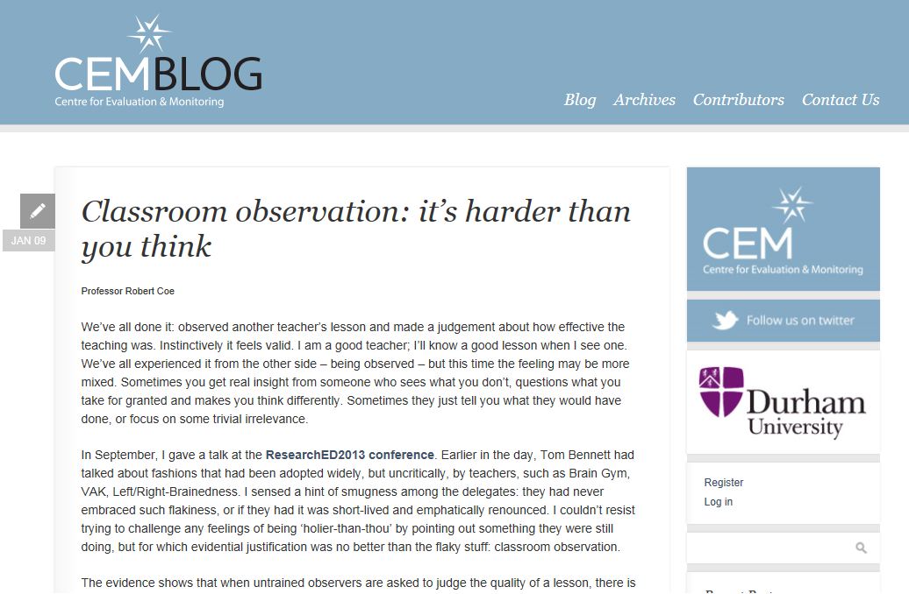
Lesson observation: It’s harder than you think
Notes:
http://www.cem.org/blog/414/

Slide 25
How do you know if teaching is working?
High-quality assessment
Not levels (generalised descriptors/criteria)
Convergent with learning goals & other evidence
Check for bias & confounds
Lesson observation
Be very cautious! (no grades or consequences)
Based on ‘Great Teaching’ evidence
Trust teachers with consistently good outcomes
Student feedback
Use validated instruments

Slide 26
Using good assessment to monitor teaching
Standardised
criteria, exemplars, context, moderation, objective
Reliable
accurate, consistent across teachers
Aligned
Captures valued learning
Notes:
cem.org

Slide 27
Of course we do evaluation …
Don’t trust the intuitive, impressionistic evaluation that is easy and automatic: be critical and rigorous
In teaching/schools feedback is absent or biased
Wrong (eg ‘Poor Proxies’, amateur lesson observation)
Short term – performance vs learning
Narrow – hard to vary contexts for transfer
Cognitive biases
Overconfidence, Dunning-Kruger: the less we know, the less we realise we don’t know
Confirmation bias: emphasise evidence supporting existing beliefs
Cognitive dissonance: beliefs align with behaviours
Sunk-cost fallacy: reluctance to abandon decisions
Halo effects: attributing positive characteristics because we see other positive characteristics
Causation: over-interpret patterns as causal
Notes:
‘Poor proxies’ – see Coe 2013 ‘Improving Education’: Coe, R. (2013) Improving Education: A triumph of hope over experience. Inaugural Lecture of Professor Robert Coe, Durham University, 18 June 2013. Essay version available at http://www.cem.org/attachments/publications/ImprovingEducation2013.pdf Video at https://vimeo.com/70471076
Lesson observation, see ‘Classroom observation: It’s harder than you think’ http://www.cem.org/blog/414/
For a good summary of relevant cognitive biases see Didau, D. (2015). What if everything you knew about education was wrong? Crown House Publishing.
Also Didau’s @LearningSpy blog: ‘Developing intuition: when can you trust your gut?’ http://www.learningspy.co.uk/training/developing-intuition-can-trust-gut/

Slide 28
Key elements of good evaluation
EEF DIY Evaluation Guide
Clear, well defined, replicable intervention
Good assessment of appropriate outcomes
Well-matched comparison group
Notes:
Coe, R., Kime, S., Nevill, C. and Coleman, R. (2013) ‘The DIY Evaluation Guide’. London: Education Endowment Foundation. [Available at:
http://educationendowmentfoundation.org.uk/library/diy-evaluation-guide
https://v1.educationendowmentfoundation.org.uk/uploads/pdf/EEF_DIY_Evaluation_Guide_(2013).pdf
http://educationendowmentfoundation.org.uk/uploads/pdf/EEF_DIY_Evaluation_Guide_(2013).pdf
https://educationendowmentfoundation.org.uk/resources/diy-guide/getting-started/

Slide 29
General principles of (professional) learning: 3. Don’t forget teaching

Slide 30
If you want your students to learn something hard, would you
Get them into groups to work it out for themselves
Provide explicit instruction in the ideas/techniques and actively manage their learning (as an expert in both the subject matter and in pedagogy)

Slide 31
All good learning & teaching …
Takes you from where you are at
Is clear what success looks like
Creates challenging expectations
Assesses and feeds back on the gap
Requires exposition and guidance from an expert
Requires a coaching & mentoring role
Benefits from peer support
Requires trust: ‘OK to fail’

Slide 32
General principles of (professional) learning: 4. Culture is crucial

Slide 33
What is trust?
Inter-dependence, risk of harm
“willingness to be vulnerable to another party based on the confidence that the latter party is (a) benevolent, (b) reliable, (c) competent, (d) honest, and (e) open”
(Tschannen-Moran & Hoy, 2000)
Good intentions, would not exploit
Lack of anxiety
Predictability, consistency of behaviour
Skills, abilities, power
Willing to share (personal) information
character, integrity, authenticity
Notes:
Tschannen-Moran, M., & Hoy, W. K. (2000). A multidisciplinary analysis of the nature,
meaning, and measurement of trust. Review of Educational Research, 70(4), 547-593.

Slide 34
Trust in school
Schools “with weak trust reports … had virtually no chance of showing improvement” (Bryk & Schneider, 2002, p. 111).
‘Academic Optimism’ (Hoy et al, 2006)
Academic Emphasis: press for high academic achievement
Collective Efficacy: teachers’ belief in capacity to have positive effects on students
Trust: teachers’ trust in parents and students
If what you are doing isn’t good, do you want to
Cover it up, ignore, hide, minimise its importance
Expose it, share, examine, maximise the learning opportunity
Notes:
Bryk, A., & Schneider, B. (2002). Trust in schools. New York: Russell Sage.
Hoy, W. K., Tarter, C. J., & Hoy, A. W. (2006). Academic optimism of schools: A force for student achievement. American educational research journal, 43(3), 425-446.

Slide 35
General principles of (professional) learning: 5. Practice makes less imperfect

Slide 36
Deliberate practice
Challenge
Specific goals
Focus on sub-tasks
Feedback
Mental representations
Notes:
Ericsson, K. A. & Pool, R. (2016). Peak: Secrets from the New Science of Expertise. Boston, MA: Houghton Mifflin Harcourt
Deans for Impact (2016). Practice with Purpose: The Emerging Science of Teacher Expertise. Austin, TX: Deans for Impact.
https://deansforimpact.org/resources/practice-with-purpose/

Slide 37
How can teachers learn to be better teachers?
@ProfCoe

Slide 38
How can teachers learn to be better teachers?
You’re a teacher.
You know how to help people learn hard stuff.
Do that.

