Slide 1

Bryanston Education Summit – 07 June 23
Understanding Stress and Coping
A Whole-School Approach
Gareth D Morewood

Slide 2
Assumptions …
Viewing a person as always a) in control & b) they are aware is a dangerous combination.
Seeing people as distressed and traumatised can #flipthenarrative on how we interact with these individuals in crisis situations – but also how we ‘set up’ learning – being pro-active is key!

Slide 3
Potential Causes & Challenges
Communication difficulties
Confusion
Unexpected change – breaking a routine
Environmental factors – heat, overcrowding, noise, etc.
Sensory differences i.e. hyper and hyposensitivity
Pain or medical problems
Medication changes
Inactivity/boredom
Demands and requests
Emotional problems and mental illness
Too many rules and restrictions
Being denied a need or getting something that they don’t want
Staff/Adults/Others
And many more…

Slide 4
Why can school (education) be such a challenging place?
For young people:
    Learning in a social setting, reading social situations, deciphering the unwritten rules
    Learning in a complex language environment with limited visual support
    Understanding and communicating with other students and adults
    Coping with change, transitions and unexpected breaks in routine
    Day to day organisation
    Generalising learning beyond the setting in which it took place
For staff and families:
    Gaining, maintaining and refocusing attention
    Motivation
    Differentiation of language and/or curriculum
    Managing behaviour **WARNING**WARNING**WARNING**
    Accommodating special interests

Slide 5
Why can school (education) be such a challenging place?
For the peer group:
  Lack of understanding
  Resenting extra attention
  Social advances that are ignored or rejected
  Distraction or disruption
  Feeling that double standards are applied (‘getting away’ with things)
  Being nervous or fearful
  Ignoring, teasing, winding up, bullying (Morewood, Humphrey & Symes, 2011)

Slide 6
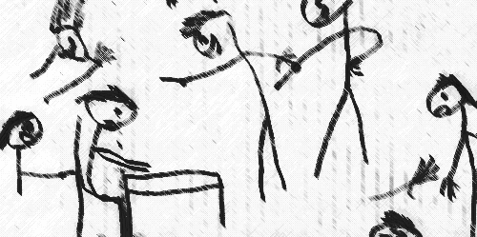
Why Can School Be Such a Challenging Place?
Taken from Humphrey & Lewis (2008)

Slide 7
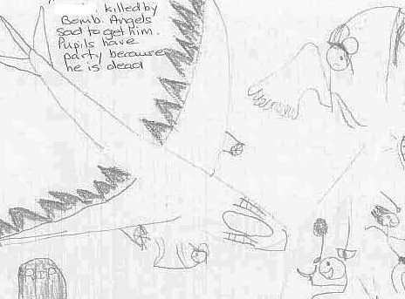
Why Can School Be Such a Challenging Place?
Taken from Humphrey & Lewis (2008)

Slide 8
"When a person is drowning that is not the best time to teach them how to swim."
(David Pitonyak)

Slide 9


Slide 10


Slide 11


Slide 12


Slide 13


Slide 14
“Masking Is Life”: Experiences of Masking in Autistic and Nonautistic Adults. Autism in Adulthood
www.liebertpub.com/doi/10.1089/aut.2020.0083
Double Empathy: Why Autistic People Are Often Misunderstood
Double Empathy: Why Autistic People Are Often Misunderstood · Frontiers for Young Minds (frontiersin.org)

Slide 15
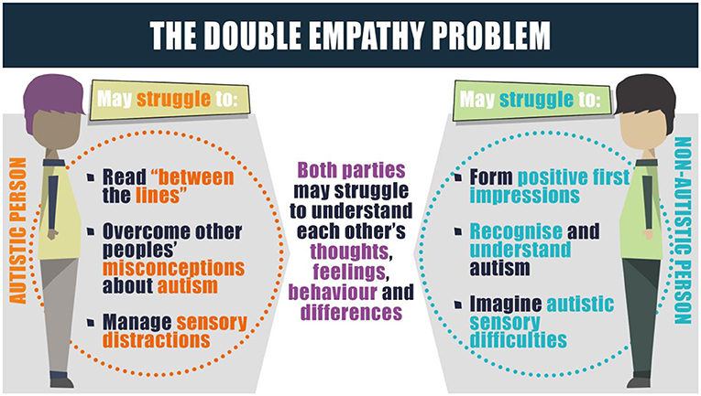

Slide 16
The Notion of Low Arousal
We also know that challenging behaviour often occurs when someone experiences a high intensity of affect.
Nobody fights when they are relaxed and easy-going.
Calm and self-control is connected, and we want the service-user or child to be in control of him- or herself, so that they can cooperate and work *with* - in partnership.
Physiological arousal can be strongly linked to the construct of stress (McDonnell et al, 2014).
Arousal and stress are considered to be important in the regulation of emotion (Reich & Zautra, 2002).

Slide 17
Key messages
Some of the key messages for consideration in developing an
approach schools and communities are:
    an evidence base isn’t always vital; something that works with only 5% of the population can still be incredibly useful – personalisation
    organisational changes cannot be affected in a zero tolerance policy – a need for flexibility and reasonable adjustments
    you need the appropriate tools to do the job – training and development is essential

Slide 18
Starting With Your Own Stress is Essential
Good arousal reduction strategies focus on our own arousal as well as our pupils/children/relatives.
Two (three) key aspects of arousal regulation include:
          (Mindfulness)
          Increased cardiac exercise
          Achieving and encouraging flow states (‘tune in’ and ‘tune out’)

Slide 19

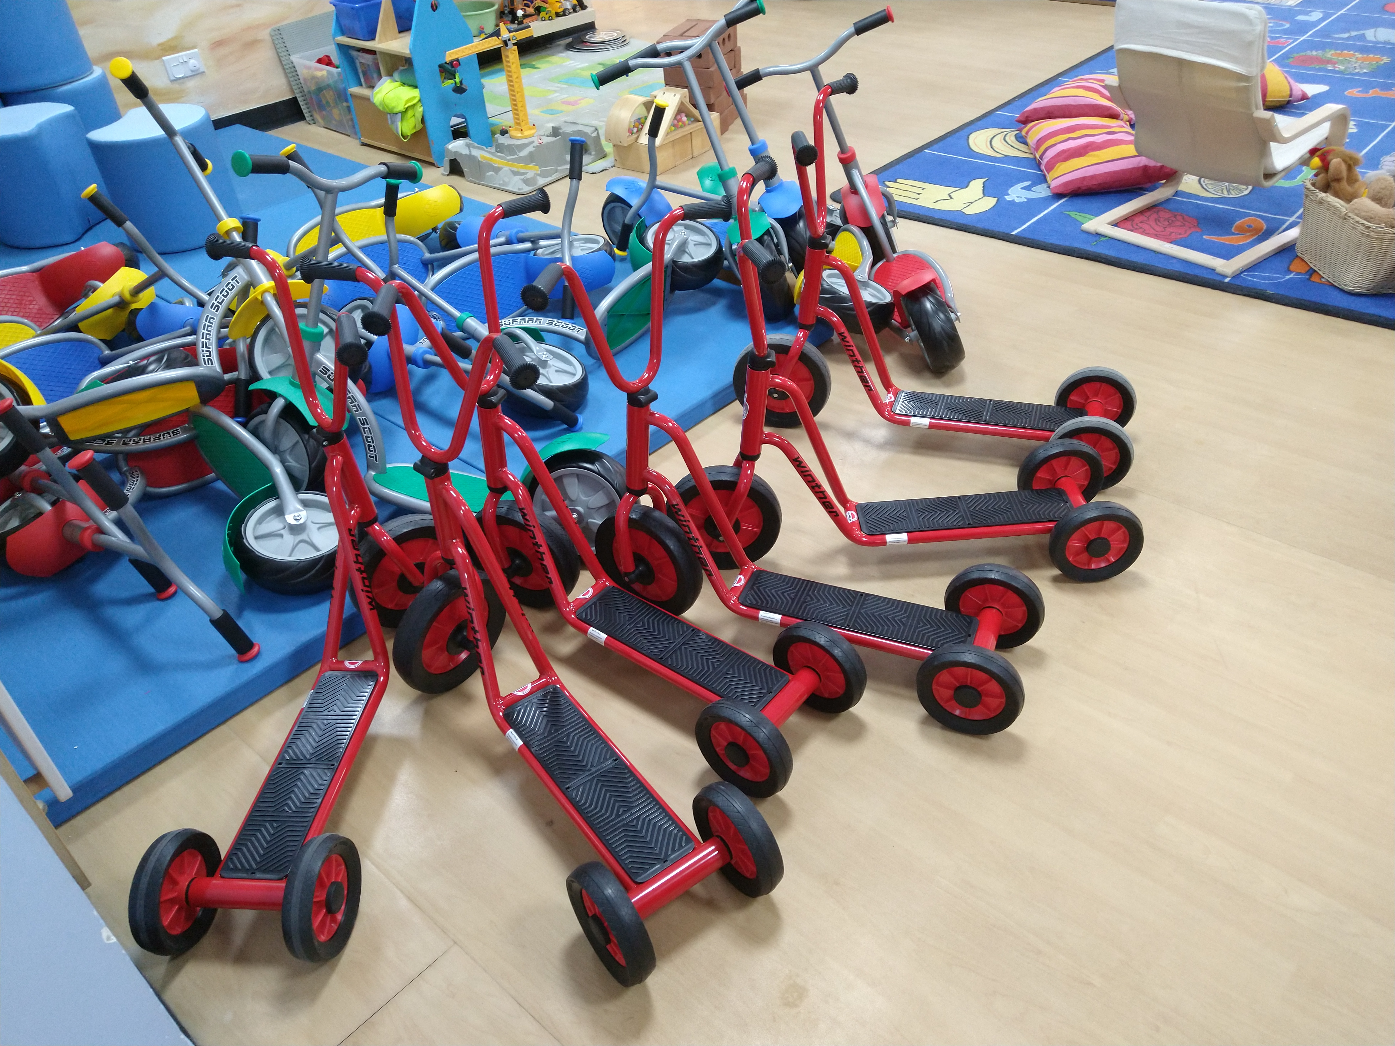

Slide 20
A Stress and Well-being Framework
Do you engage at least weekly with any of the following:
Light cardiac activity (2-3 hours of walking per week)?
Intensive cardiac exercise (1-2 hours a week)?
Participate in a physical sport?
10-15 minutes per day of some form of Mindfulness or meditation?
Drink more than 2 litres of fluid per day?
Have any absorbing hobbies or interests?
Regularly eat 3 meals (of whatever size) per day?
Suffer from gastric complaints, headaches and other minor ailments on a regular basis?

Slide 21
Achieving and Encouraging Flow States
Achieving a sense of flow is an important component of wellbeing and good stress management.
Flow experiences require complete immersion in an activity, whether playing a musical instrument, completing a complex technical task, or reading a book (Nakamura and Csikszentmihalyi, 2009).
Athletes can often refer to such states as ‘being in the zone’.

Slide 22
Achieving and Encouraging Flow States
Flow can also happen within social interactions.
For example: when one is talking to a good friend or playing with a young child (Csikszentmihalyi, 1990).
A flow state can also be achieved when the skills and resources available to an individual are fully engaged in managing an activity.

Slide 23
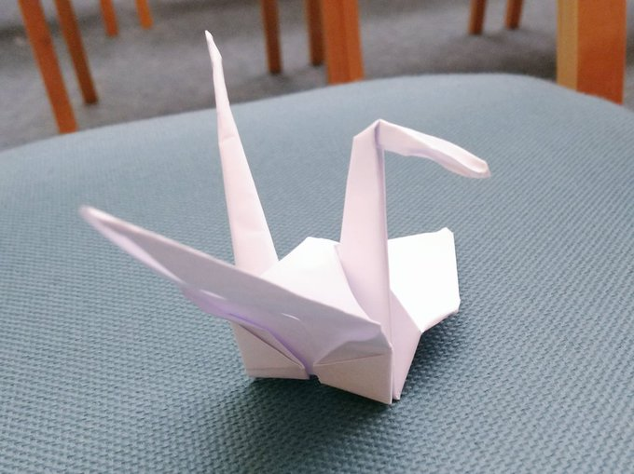
Achieving and Encouraging Flow States

Slide 24
Positive Psychology - Three Good Things Exercise
Participants were asked to write down three things that went well each day and their causes every night for one week (Seligman, 2005).
In addition they were asked to provide a causal explanation for each good thing.
You can see how Seligman’s ideas can be translated to school/home environments.
For 1 week at the end of each day, staff could write about 3 positive things that occurred in their day.
You can also ask them to describe 3 things that made them smile.

Slide 25
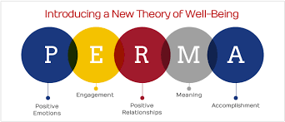
Positive Psychology – The PERMA Model
Seligman’s PERMA model of positive psychology is a useful tool for frontline staff to employ
Focus on positive recording, moments of happiness and building meaningful relationships with the young people we support

Slide 26
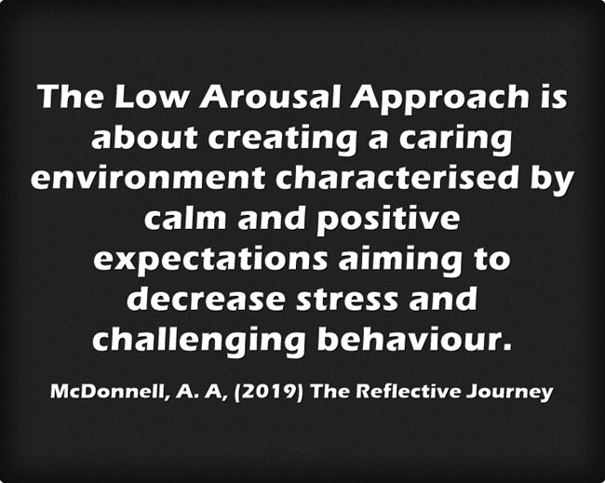

Slide 27
What can we do to improve the educational experiences and outcomes of autistic young people?
Agent of change
Developing the school environment
Flexible provision
Direct support and intervention
Policy development and embedding practice
Training and development of staff
Peer education and awareness
Creating a positive ethos
Morewood, G. D., Humphrey, N. & Symes, W. (2011) Mainstreaming autism: making it work. Good Autism Practice Journal 02.12.11, 62-68.

Slide 28
Developing the School Environment
Think about things that are ‘within our gift’ to change – don’t park the problem within the child.
Social environment
Communication environment
Emotional environment
Physical (sensory) environment

Slide 29

The Saturation Model
Autism and inclusion: the saturation model explained http://ow.ly/QcST30qe7YG
Two short films
http://ow.ly/CRUF30qe7Xm & http://ow.ly/VFfP30qe7Xl
The original paper
http://ow.ly/WJEc30qe80H

Slide 30
“We need schools where difference is valued and where there is less emphasis on conformity and greater focus on harnessing strengths in order to enable all, staff and students alike….to be the best they can become”
Professor Rita Jordan
‘Personalisation NOT Normalisation’
Dr Damian Milton

Slide 31
MEDICAL MODEL THINKING | SOCIAL MODEL THINKING
Person is faulty | Person is valued
Diagnosis | Strengths and needs defined by self and others
Labelling | Identify barriers and develop solutions
Impairment becomes the focus of attention | Outcome based programme designed
Assessment, monitoring, programmes of therapy imposed | Resources are made available to ordinary services
Segregation and alternative services | Disability Equality Training for All
Ordinary needs put on hold | Encourage social relationships
Re-entry if normal enough OR Permanent Exclusion | Diversity welcomed and disabled person is Included
Society remains unchanged | Society evolves
(Adapted from Micheline Mason 1994 & R. Rieser 2005)

Slide 32
Applying Low Arousal Approaches
The core principals are about:
  understanding the Low Arousal Approach and how it can improve outcomes for young people, staff and families
  understanding stress and how best to support yourself and others
  improving classroom pedagogy
  challenging and supporting positive whole-school systems.
A strong pillar throughout is co-production – working jointly on identifying challenges and finding solutions to improve the outcomes for young people.

Slide 33
Planned Escape
Planned Escape
From the original interview almost a decade ago
http://ow.ly/h4h030qe7H1
Hear more about establishing a Planned Escape strategy, that worked!
http://ow.ly/ojdf30qe7H2 & http://ow.ly/zAZ330qe7H0

Slide 34
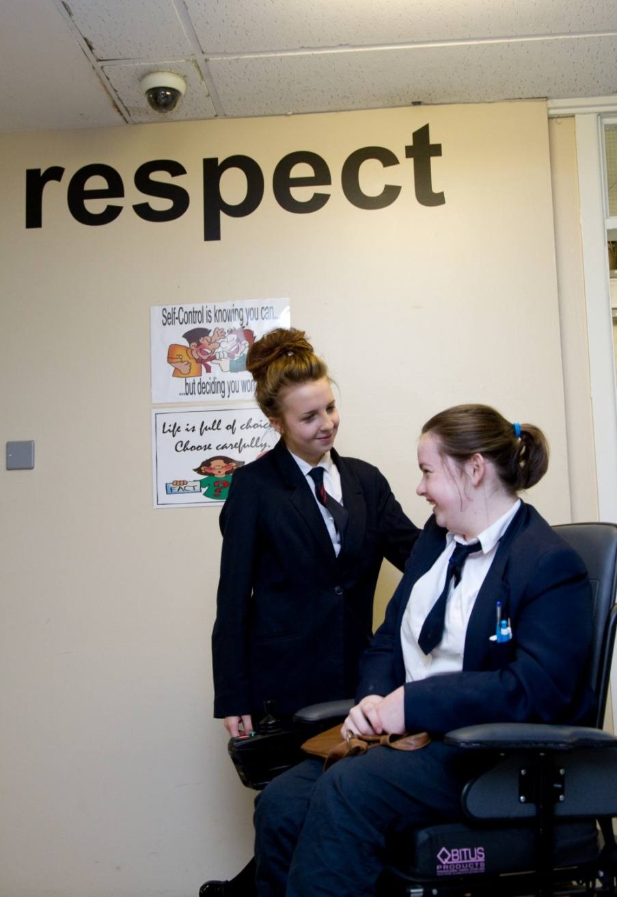
Peer education and support is essential
‘The education of the peer group is an essential part of moving towards a truly inclusive community’
Gareth D Morewood (2011)

Slide 35
Ensure clear communication with parents/carers
Keep parents/carers informed
Make sure they know who to contact and how
Provide honest communication – no long-term benefit in providing anything but the truth
Listen to parents/carers – give them time
Try to avoid uncertainty/misinterpretation
MOREWOOD, G. D., & BOND, C. (2012) Understanding Parental confidence in an inclusive high school: a pilot survey. Support for Learning, Vol. 27 No.2, p53-58 Wiley Blackwell Publishing.

Slide 36

LASER – a new project from Studio III

Slide 37
Book Chapter
Morewood, G.D., McDonnell, A.A. & McDermott, R.A. (2021). ‘The LASER Approach.’ In New Trends and Promising Directions in Modern Education New Perspectives 2021, Ed. By M. Aydogmus. Meram: Palet Publications.
Link to Chapter - http://ow.ly/KV7750KAlT1

Slide 38


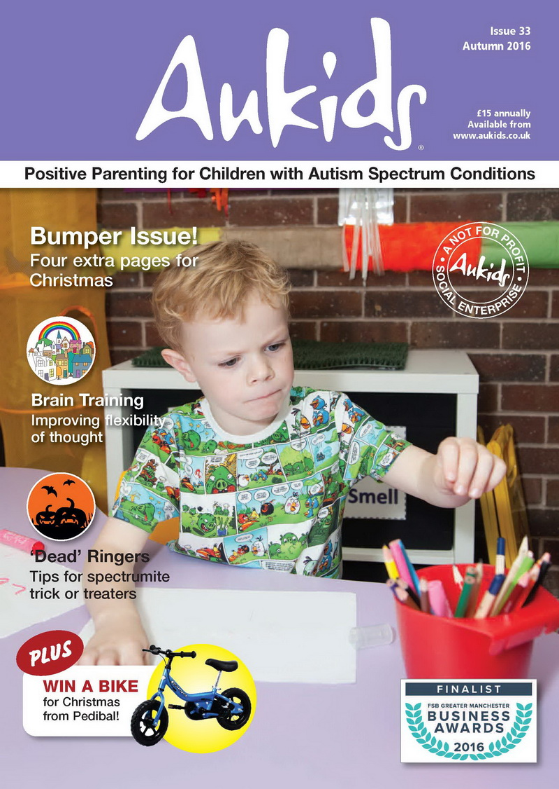


www.aukids.co.uk

Slide 39
The ‘Reactive’ Approach & Impact
1
Anxiety provoking problem occurs
2
Pupil experiences overload
3
Demonstrates ‘fight or flight’ response
4
Teachers react after the event, under pressure
5
Pupil loses faith in school environment: trust broken
6
‘On edge’ pupil copes less well with new challenges

Slide 40
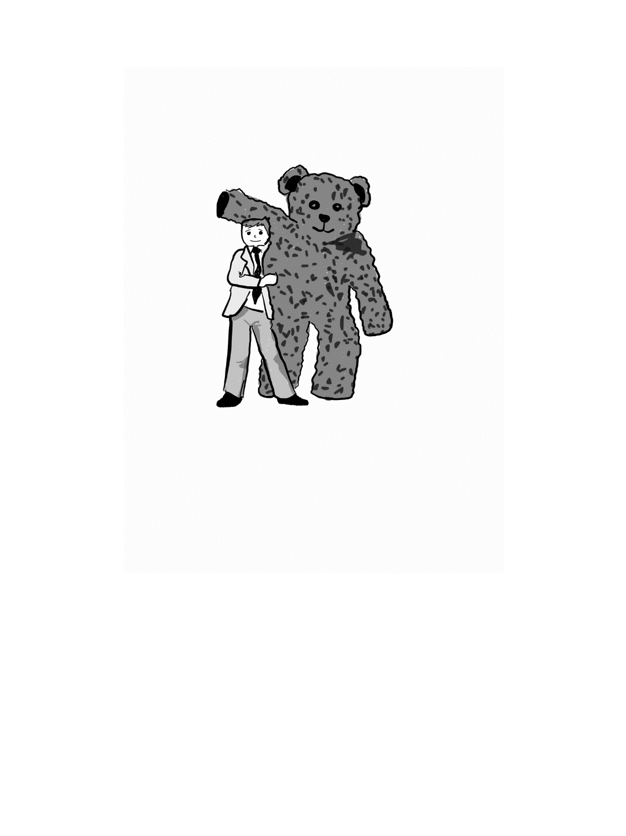
Predicting Obstacles: Parents & Carers
Meet key personnel early
Classroom tips chart
Point out obvious stumbling blocks
Share ‘pivotal comforts’ early
Use positive language, motivate!
Invite openness and honesty
Pave the way for shared problem-solving

Slide 41
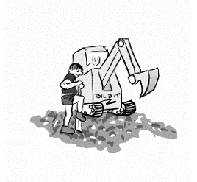
Predicting Obstacles: Teachers & SS
Create Stress Support plan with family
Student passport
Adjustments & flexibility to policy & practice
Personalize the approach
Ensure pupil knows ‘what to do if…’
Watch out for ‘trip wire’ practices
Good communication between staff

Slide 42
Using Metacognition with Student Passports
Student Passport
Teacher
Teaching Assistant
Parent/ Carer
Student /Learner
Keeps the young person central to provision
Essential as part of our student centred approach
A useful tool to engage parents/carers

Slide 43
Using Metacognition with Student Passports
Student Passports
Watch the film - http://ow.ly/PXUn30pIgTh
Read an article - http://ow.ly/EXKI30pIgTi
Also these #SENCology blogs http://ow.ly/HuHG30pIgTf (2015) http://ow.ly/DDK230pIgTg (including revised template, 2018)

Slide 44
Spot What Is Going Well & Develop
‘If you were the boss managing a team, and you only ever spoke to them when there was something to criticise, the chances are you’d not have a very motivated team. The same psychology works here…’
‘Tell them what they did right and why! There’s nothing in the word ‘no’ that tells a school what it should be doing instead.’
Championing Your Teen at Secondary School

Slide 45
Working On The Relationship: Parents
Praise the good stuff!
Avoid Blazing Keyboard Syndrome
Use language that motivates
Summarise your understanding of other’s positions
Focus on the obstacle and identify its root cause
Keep it real: talk about emotions

Slide 46
Working On The Relationship: Teachers
‘Catch-ups’ rather than ‘meetings’
Avoid engaging in tense e-mail exchanges
‘Own your own fragility’
Be aware of the language you use e.g. ‘incident’
Summarise your understanding of other’s positions
Don’t dominate, collaborate

Slide 47

Collaboration Is Key
‘An inclusive school culture means building a relationship with a young person that has the same components no matter what level of an organisation that they approach’.
Championing Your Autistic Teen at Secondary School
‘The Saturation Model’ Gareth Morewood, Wendy Symes, Neil Humphrey. 2011.
‘Mainstream Autism: Making It Work’. Good Autism Practice Journal. 12, 2. P62-68.

Slide 48
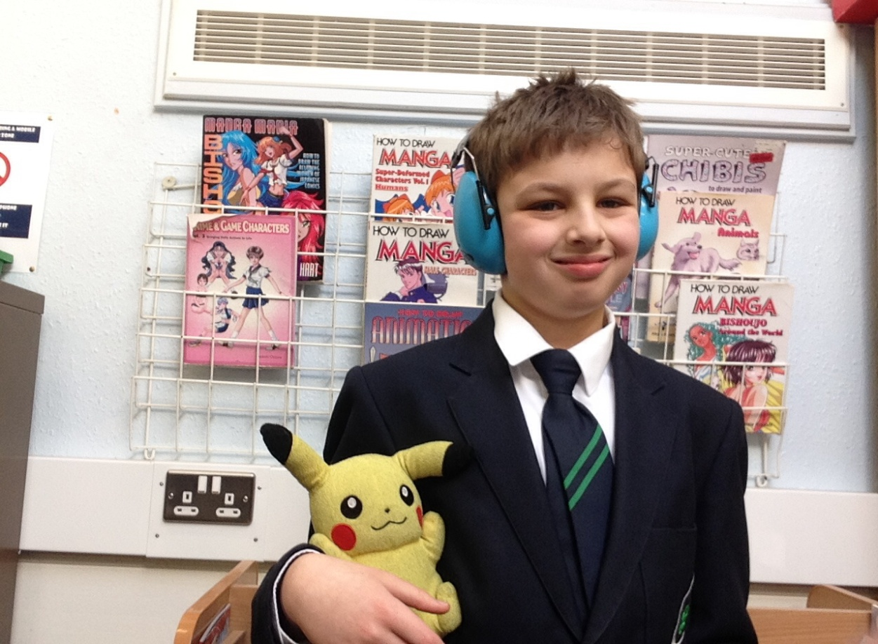
“School is really good because they have many autistic students and they understand us. I think I will have a great time at school because they know how to deal with me and support me. Social time is great as I get to hang out with other students who like to share my interests.”
Bobby, aged 11

Slide 49


Slide 50
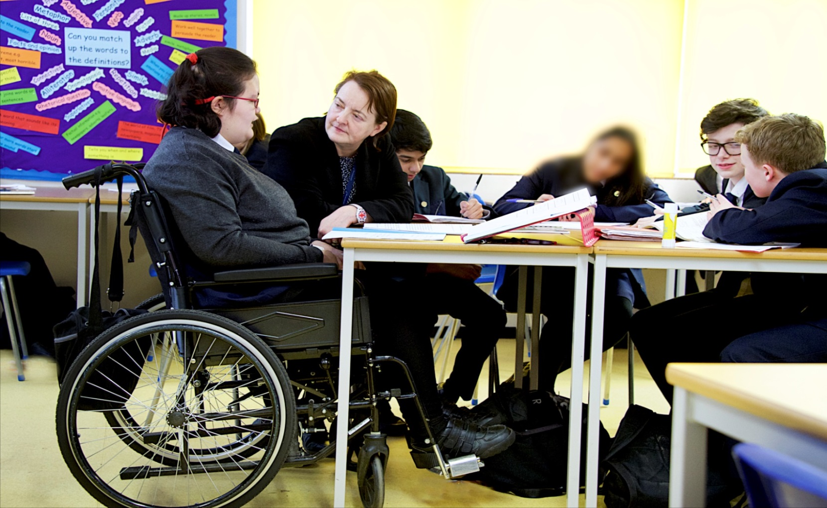
“I get to do everything my friends do, just that sometimes I have things changed a little so I can join in properly.” Lisa, aged 15

Slide 51
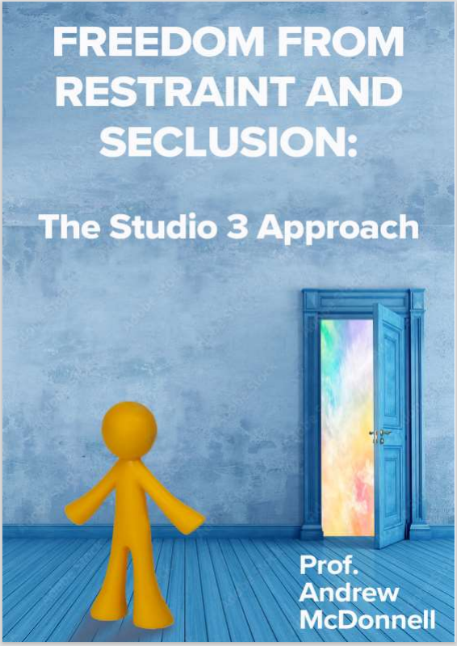
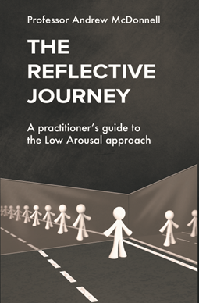
www.studio3.org/shop
Use CODE
GDM15
For 15% OFF

Slide 52

New Book
‘I’d recommend this to all parents looking to support their child in school and to all teachers who want to build a collaborative approach with pupils and parents.’
Richard Nurse, parent and founder of Picturepath.
‘This book’s grounded, compassionate and practical approach will be a boon for all involved in the education of autistic teenagers. I highly recommend it.’
Mary Myatt, education writer and curator of Myatt and Co.
‘This should be essential reading for parents of autistic children who attend a mainstream secondary school. A remarkable achievement.’
Neil Humphrey, Sarah Fielden Chair: Psychology of Education, University of Manchester.
‘Drenched in lived experience, this is a superb guide. You’ll learn something new in every chapter.’
Matt Keer, parent contributor to Special Needs Jungle website.

Slide 53
Links
FREE webinars - www.studio3.org/free-webinars
FREE Newsletter - www.studio3.org/so/d5OUpnBWt?languageTag=en
LASER Prog - www.studio3.org/laser-online
Low Arousal Training - www.studio3.org/low-arousal-online
Films - Videos Archives - Gareth D Morewood (gdmorewood.com)
SENCology Blog - SENCology | Optimus Education Blog (optimus-education.com)

Slide 54


Slide 55

www.studio3.org @studioIII www.gdmorewood.com @gdmorewood
Practical Ideas For Inclusive Classrooms

